Slide 1




#brightonSEO
Using Python with (Chat) GPT to automate Content Creation…
Andrew Timmins Online Marketing Surgery Ltd
https://yourseo.agency/brightonseo
https://github.com/andrewtimmins

Slide 2


#brightonSEO
Disclaimer…
AI is advancing at such a rate
that by the time you view this,
some of this content may
already be out of date!
Notes:
I hate to put a disclaimer up as the first slide, however, over the last few months AI has progressed faster than at any point in human history; almost daily new and exciting updates are being released, not just to OpenAI offerings but to other systems across the world, so as the disclaimer goes… some of this might already be out of date as I stand here today!

Slide 3
#brightonSEO
What is GPT?
GPT (generative pre-trained transformer) is a language model trained
on a large amount of text taken
from books, articles and websites
and other sources.
Notes:
Before we dive into how to use GPT for content creation, let's first understand what GPT is. GPT is a language model that is pre-trained on a massive amount of text data, such as books, articles, and websites.
This pre-training allows GPT to understand the structure and context of human language, making it capable of generating human-like text.

Slide 4
#brightonSEO
Why automate content creation?
Saves time…
Saves money…
Provides inspiration...
Respond quickly…
Notes:
Saves Time… Can cut down the time needed to produce content by around 40%
Saves Money… The old adage that time is money and that’s certainly the case here; with content writers taking roughly 40% less time to create content (either draft or final).
Provides inspiration… We all get it; writers block; be it because we’re not familiar with the subject or we’re just not having a great day; content automation helps provide the basis of a piece of content.
Respond quickly… With a reduction in time to create content, semi-automated research thanks to inspiration, content creators and move quickly to target new and emerging topics.

Slide 5
#brightonSEO
The first step
is to define your content type…
Blog Posts…
Product Descriptions…
Social Media Posts…
Email Newsletters…
FAQs…
Notes:
The first step in using GPT for content creation is to define your content type. This will help you determine the type of GPT model to use and how to fine-tune it.
Some examples of content types include:
Blog Posts
Product Descriptions
Social Media Posts
Email Newsletters
Frequently Asked Questions

Slide 6

#brightonSEO
What automation cannot replace….
(…yet)
Humans!
Human intervention is
Still required to vet
and rework created
content.

Slide 7

#brightonSEO
What? I need to vet and modify content?
AI isn’t perfect.
What you provide to it in terms
of a subject, context and
noteworthy points,
really matter!
Notes:
Simply put, AI isn’t quite ready for the big time just yet… It’s getting there, but for now out jobs are most definitely safe!
As with most things, content creation using AI essentially follows the principle of GIGO; garbage in, garbage out, so what we need to do is ensure we provide enough pertinent information regarding the topic, points and anything else worthy of inclusion so AI has the best possible chance of coming back with something useful.
If we simply say “Give a paragraph on Tesla cars”, chances are we will get something fairly wishy-washy but if we were to say “Give me a paragraph on Tesla electric vehicles and their battery technology.”, chances are will we get something more suited to what we originally intended.

Slide 8
#brightonSEO
An example of non-vetted piece of content…
“BrightonSEO started from a meet-up of a few digital marketers at a pub in Brighton in 2010, exchanging ideas on their working domains. Today BrightonSEO conference with an info generating, stay-code boasting, elective hot result driven wham-information at #BrightonSEO presentations. Bark Conversion speaking on Instant Fancy Cards shortly.”
Notes:
As you can see, ChatGPT can sometimes get things a little wrong, filling in the blanks with gibberish it see’s as potential content.
Sometimes the output can actually read as though it’s a well written, well thought out piece of copy; however; because of this ‘filling in the blanks’ approach, ChatGPT can essentially makeup facts, figures and other random snippets as quotes – which could lead to the spread of misinformation.

Slide 9
#brightonSEO
Do I need to be one with code to get started?
Not at all.
OpenAI provides a handy Web Portal to use Chat GPT.
https://chat.openai.com/

Slide 10

#brightonSEO
I love to code and want to get my developer on…

Slide 11



#brightonSEO
So, what do you use at OMS?
GPT-3
Chat GPT
Python
Notes:
Originally we used GPT-3 but as many of you know this has now grown into GPT-4.
Thanks to a pretty much over-night rise to fame, Chat GPT (using GPT3.5) is now our preferred method for generating content automatically using almost natural language like requests; we haven’t quite moved to using GPT4 just yet.
As we like to build internal tools to help with out day to day tasks, we use Python as our preferred language.

Slide 12
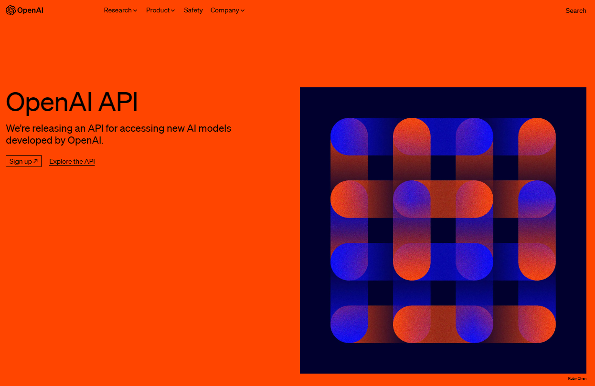
#brightonSEO
Create yourself an OpenAI
Account…
https://platform.openai.com/signup
Notes:
Visit OpenAI and create yourselves an account.

Slide 13
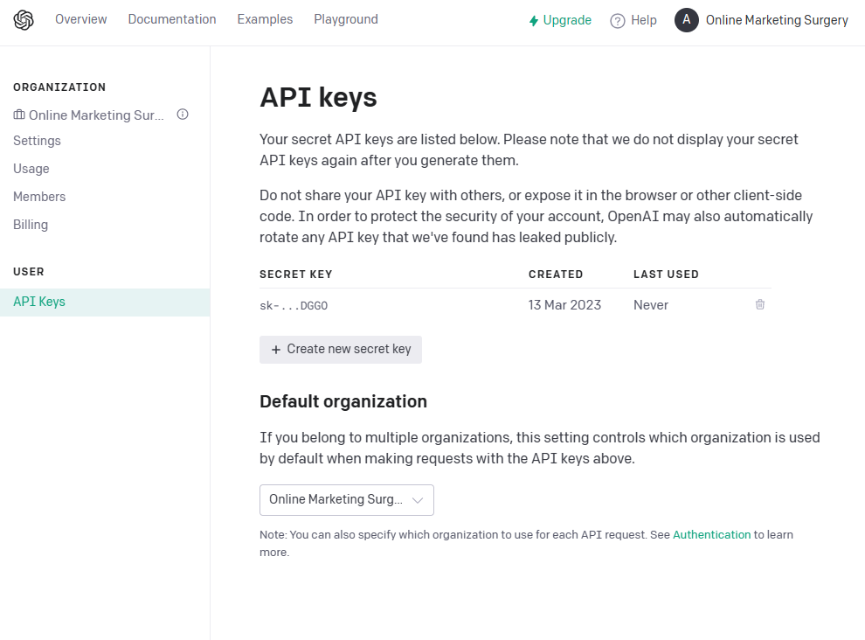
#brightonSEO
Create an API Key…
Remember to keep your key safe!
Notes:
To call any of OpenAI’s products, you will require an API key…

Slide 14
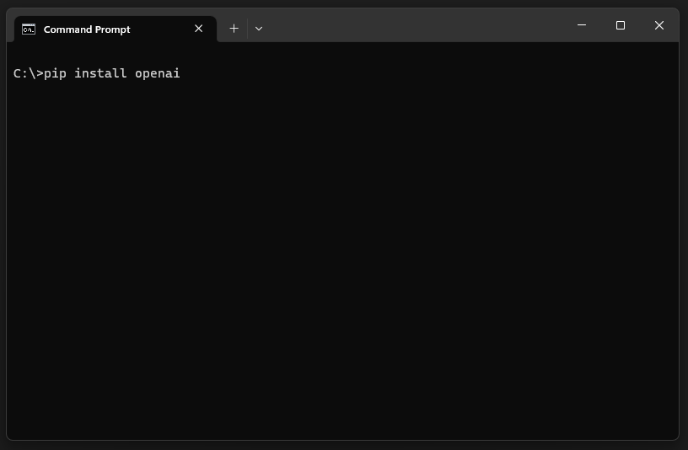
#brightonSEO
Install The OpenAI API client…
> pip install openai
Notes:
The quickest and easiest way to use ChatGPT is to use the OpenAPI API client; so in a terminal window, simply enter pip, install openai to get things rolling.

Slide 15
#brightonSEO
How to use the API…
Constructing a completion…
Setting parameters…
Sending the request…
Handling the response…
Notes:
So there are just a few things we need to do to use the API.
Construct a chat completion
Set parameters/options
Send a request to the AI
Handle the request from the AI
Let’s take a look at some code…

Slide 16
#brightonSEO
Constructing a completion…
completion = openai.ChatCompletion.create(
model = 'gpt-3.5-turbo',
messages = [
{"role": "user", "content": "Write a summary of the history of the BrightonSEO event."}
],
temperature = 0
)
Model = The model we’re going to use (e.g. GPT or Davinci)
Role = System, User or Assistant
Temperature = 0: more accurate, 2: more random
Notes:
We can create a simple completion object using the example code shown here.
There are many, may different options available so I’ve tried to keep this to the bare minimum.
The main 3 we have to provide are: mode, role and temperature.
Model tells the system which model we’re going to be using; in this example we’re using GPT3.5-Turbo, which is the same as that which powers ChatGPT.
Role allows us to set upto 3 different aspects:
System is used to give the AI itself context, for example “You are a Python developer.”
User is the question or content we would like the AI to answer, rewrite, or perform a task from.
Assistant gives the AI more meaningful context or useful pointers, such as “Use XYZ library.”
In the example code above, we provide the AI with just the task within the user content; in this case we’re asking it to give us a summary of the history of BrightonSEO.
Temperature controls how accurate the response is. 0 being the most accurate possible with almost no random filler, 2 having the most random amounts of filler possible This goes up in .1 increments, in the example above, we’re going for the most accurate possible.

Slide 17
#brightonSEO
Sending the request…
aiResponse = completion['choices'][0]['message']['content'])
Handling the response…
print(aiResponse)
Notes:
We really didn’t send the request with the first line; it was actually sent when we created the completion in the previous code… This simple assigns the output to our variable aiResponse so we can use it later on in any other code.
As the example here shows, we simply print the output to the screen… The next slide shows an example of what the output was that got returned.

Slide 18
#brightonSEO
Putting it all together…
import openai
openai.api_key = “***key here***"
completion = openai.ChatCompletion.create(
model = 'gpt-3.5-turbo',
messages = [
{"role": "user", "content": "Write a summary of the history of the BrightonSEO event."}
],
temperature = 0
)
print(completion['choices'][0]['message']['content'])

Slide 19
#brightonSEO
Example output from our script…
“BrightonSEO is a digital marketing conference that takes place twice a year in Brighton, UK. The event was founded in 2010 by Kelvin Newman, who was working as a freelance SEO consultant at the time. The first BrightonSEO conference was held in a pub with just 35 attendees, but it quickly grew in popularity and moved to larger venues.”
Notes:
As you can see, the output from the example code is pretty good; for most uses this wouldn’t need to be modified.

Slide 20

#brightonSEO
So, this is cool, but how can we automate creation?
Notes:
So far we’ve seen how to create content from a static block of text…. What we’re all interested in is how we can possibly create content automatically, with minimal input, right?

Slide 21
#brightonSEO
Automating WordPress Posts…
Scrape news site…
Send scraped content to GPT…
Create draft post…
Check & publish post…
Notes:
So in our example use case, we’re going to look at how WordPress posts (blog/news/custom) can be automated using the latest industry news articles.
This example script will be able to take a news article from the BBC news site, parse the content, pass that content to GPT and create a new, rewritten post ready to be reviewed and published.

Slide 22
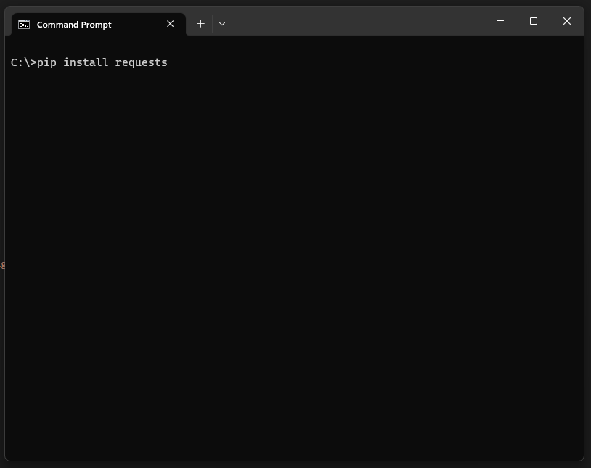
#brightonSEO
Install The Requests library…
> pip install requests
Notes:
The quickest and easiest way to talk to Wordpress from python is to use Python’s requests library; so in a terminal window, simply enter pip, install requests to get things rolling.

Slide 23
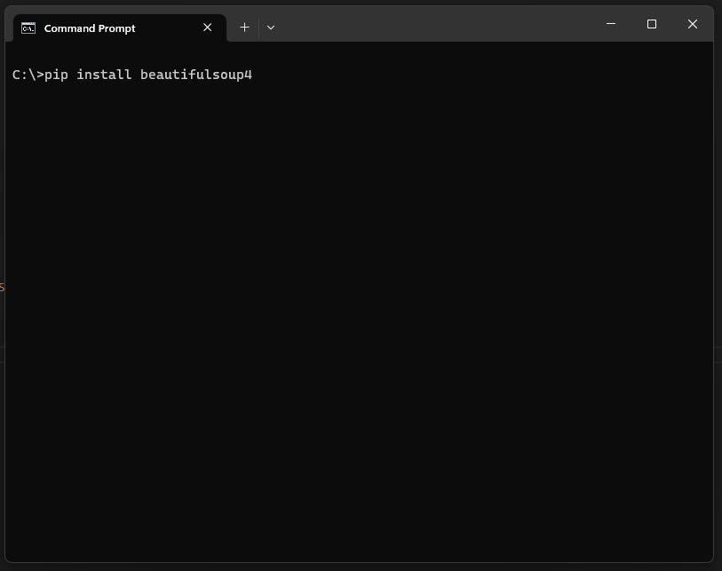
#brightonSEO
Install The Beautiful Soup library…
> pip install beautifulsoup4
Notes:
One of the easiest ways to scrape web page data from python is to use the Beautiful Soup library; so in a terminal window, simply enter pip, install beautifulsoup4 to get things rolling.

Slide 24
#brightonSEO
Scraping the news site…
import requests
from bs4 import BeautifulSoup
# Configurable options
newsURL = "http://feeds.bbci.co.uk/news/rss.xml"
# Fetch the 10 latest news article
xmlResponse = requests.get(newsURL)
xmlSoup = BeautifulSoup(xmlResponse.text, "html.parser")
newsArticles = xmlSoup.find_all('item')
current_item=0
for item in range(10):
articleURL = newsArticles[current_item].guid.text
articleHeadLine = newsArticles[current_item].title.text
current_item+=1
print(newsArticles[0].title.text)
print(newsArticles[0].guid.text)
# Get the first news article in the list, we're not worrying about the others in this example
articleResponse = requests.get(newsArticles[0].guid.text)
articleSoup = BeautifulSoup(articleResponse.text, "html.parser")
# Find all instances of <P></P> tags
articleScrapedContent = articleSoup.find_all('p')
articleText = ""
for p_tag in range(len(articleScrapedContent)):
if p_tag < 0:
pass
else:
articleText = articleText + articleScrapedContent[p_tag].text
print(articleText)
Notes:
Here is an example script using beautiful soup; the first thing we do is use the BBC news XML feed to obtain the top 10 news articles (these change almost hourly), making sure we grab the title and the URL.
We then select the first (latest) entry in the list and begin the scraping process.
This is where some customisation may be required if you wish to adapt this example; the BBC news site wraps most of it’s content within standard P (paragraph) tags, which is why this script will look for all instances and extract the text within those tags.

Slide 25
#brightonSEO
Send content to GPT…
# Build the completion based on the extracted content for the content
contentCompletion = openai.ChatCompletion.create(
model = 'gpt-3.5-turbo',
messages = [
{"role": "user", "content": "Rewrite the following text to be more concise: " + articleText}
],
temperature = 0
)
# Place our new content into the variable wpPostContent
wpPostContent = contentCompletion['choices'][0]['message']['content']
# Build the completion based on the extracted content for the content
titleCompletion = openai.ChatCompletion.create(
model = 'gpt-3.5-turbo',
messages = [
{"role": "user", "content": "Rewrite the following text to be more concise: " + newsArticles[0].title.text}
],
temperature = 0
)
# Place our new slug into the variable wpSlug, transforming it to be URL safe
wpSlug = titleCompletion['choices'][0]['message']['content']
wpSlug = wpSlug.lower()
wpSlug = wpSlug.replace(" ", "-")
Notes:
Here you can see two completions…
The first is for the scraped content, the second is for the scraped title.
We do this so we can hopefully obtain not only rewritten content but also rewritten titles (which will also be converted into URLs/slugs).
There may be some issues doing it this way, most notably if the title text is fairly limited; there is only so many ways to rewrite a short amount of text before you repeat yourself!
It’s worth noting here that I’m not providing any System or Assistant roles so the AI is working purely from the content itself; you can tweak the initial line of “rewrite the following text to be more concise” to something that suits your application better if you feel the output is not working as well as it could do. You may also add in the missing roles.

Slide 26
#brightonSEO
Create the draft post…
wpUser = "***username here***"
wpPaassword = "***password here***"
wpURL = 'https://***url here***/wp-json/wp/v2/posts’
# Create the authentication header for Wordpress
wpCredentials = wpUser + ":" + wpPaassword
wpToken = base64.b64encode(wpCredentials.encode())
wpHeader = {'Authorization': 'Basic ' + wpToken.decode('utf-8'), 'Content-Type': 'application/json’}
# Place our new slug into the variable wpSlug, transforming it to be URL safe
wpSlug = titleCompletion['choices'][0]['message']['content']
wpSlug = wpSlug.lower()
wpSlug = wpSlug.replace(" ", "-")
#print(titleCompletion['choices'][0]['message']['content'])
#print(wpPostContent)
#print(wpSlug)
# Send the new post to Wordpress in a draft state
wpData = {
'title' : titleCompletion['choices'][0]['message']['content'],
'status': 'draft',
'slug' : wpSlug,
'content': wpPostContent
}
wpResponse = requests.post(wpURL,headers=wpHeader, json=wpData)
print(wpResponse)
Notes:
Here’s a super simple block of code to push our newly rewritten content into WordPress as a draft post.
If you remember back to the start of the presentation, I mentioned AI does a great job but it’s not without it’s flaws. This allows for you to check, rework and when happy publish the rewritten article.

Slide 27
#brightonSEO
Putting it all together…
import requests
import base64
import openai
from bs4 import BeautifulSoup
import warnings
# Configurable options
openai.api_key = "***key here***"
wpUser = "***username here***"
wpPaassword = "***password here***"
wpURL = 'https://***url here***/wp-json/wp/v2/posts'
newsURL = "http://feeds.bbci.co.uk/news/rss.xml"
# Create the authentication header for Wordpress
wpCredentials = wpUser + ":" + wpPaassword
wpToken = base64.b64encode(wpCredentials.encode())
wpHeader = {'Authorization': 'Basic ' + wpToken.decode('utf-8’),
'Content-Type': 'application/json'}
# Fetch the 10 latest news article
xmlResponse = requests.get(newsURL)
xmlSoup = BeautifulSoup(xmlResponse.text, "html.parser")
newsArticles = xmlSoup.find_all('item')
current_item=0
for item in range(10):
articleURL = newsArticles[current_item].guid.text
articleHeadLine = newsArticles[current_item].title.text
current_item+=1
#print(newsArticles[0].title.text)
#print(newsArticles[0].guid.text)
# Get the first news article in the list, we're not worrying about the others in this example
articleResponse = requests.get(newsArticles[0].guid.text)
articleSoup = BeautifulSoup(articleResponse.text, "html.parser")
articleScrapedContent = articleSoup.find_all('p')
articleText = ""
for p_tag in range(len(articleScrapedContent)):
if p_tag < 0:
pass
else:
articleText = articleText + articleScrapedContent[p_tag].text
#print(articleText)
# Build the completion based on the extracted content for the content
contentCompletion = openai.ChatCompletion.create(
model = 'gpt-3.5-turbo',
messages = [
{"role": "user", "content": "Rewrite the following text to be more concise: " + articleText}
],
temperature = 0
)
# Place our new content into the variable wpPostContent
wpPostContent = contentCompletion['choices'][0]['message']['content']
# Build the completion based on the extracted content for the content
titleCompletion = openai.ChatCompletion.create(
model = 'gpt-3.5-turbo',
messages = [
{"role": "user", "content": "Rewrite the following text to be more concise: " + newsArticles[0].title.text}
],00
temperature = 0
)
# Place our new slug into the variable wpSlug, transforming it to be URL safe
wpSlug = titleCompletion['choices'][0]['message']['content']
wpSlug = wpSlug.lower()
wpSlug = wpSlug.replace(" ", "-")
#print(titleCompletion['choices'][0]['message']['content'])
#print(wpPostContent)
#print(wpSlug)
# Send the new post to Wordpress in a draft state
wpData = {
'title' : titleCompletion['choices'][0]['message']['content'],
'status': 'draft',
'slug' : wpSlug,
'content': wpPostContent
}
wpResponse = requests.post(wpURL,headers=wpHeader, json=wpData)
print(wpResponse)
Notes:
I know this is a lot to take in, and believe me, it took me a few attempts to get this to fit on this slide, however this little script when run will take the latest news article from the BBC news site, process it through GPT and produce a new, draft post within Wordpress. This code is available to download from the URL at the end of this presentation, so please don’t worry about writing this down right now! ;-)

Slide 28
#brightonSEO
The content scraped
from a news article…
Controversial social media influencer Andrew Tate and his brother Tristan are to be moved from custody to house arrest with immediate effect, a Romanian judge has ruled. The ruling by the Court of Appeal in Bucharest replaces the latest period of custody, which was to end on 29 April. Two associates, Georgiana Naghel and Luana Radu, are also being released."
Notes:
This is a segment of the original scraped news article.

Slide 29
#brightonSEO
That content, output from GPT, ready for our post…
Social media influencer Andrew Tate and his brother Tristan, along with two associates, have been moved from custody to house arrest by a Romanian judge. The ruling replaces their latest period of custody, which was due to end on 29 April.
The four have been ordered to remain in their homes unless they have judicial permission to leave.
Notes:
As you can see, the output from the snippet, the rewrite was pretty successful. The content generated is now unique enough to pass as an original piece of work.

Slide 30

#brightonSEO
See this in action….
https://www.theaitimes.co.uk/
Notes:
If you’d like to see this script running in a real world example, you can view it at The AI Times….

Slide 31

#brightonSEO
Making use of the example code…
A few ideas.
Notes:
So now we’ve seen how easy it is to take content, rework it with GPT, where do you go from here?
Whilst I’ve shown the basics by scraping the BBC news site to produce up-to-date articles for our own fictious Wordpress site, there are many other ways this code can be used.

Slide 32





#brightonSEO
Change the input
Notes:
If you change the input from being that of scraped content to that provided by a client, or maybe simple paragraph of text of an idea you may have that you’re stuck on, maybe a heap of keywords you’d like to be written into a meaningful paragraph or two; the list is endless really.

Slide 33
#brightonSEO
Change the output
Notes:
You can change the output; you don’t have to push the content into Wordpress, you can use services like Zapier or other API’s to push into other systems, for example, Teamwork, Wryke, Trello, etc.

Slide 34



#brightonSEO
Add additional services
Notes:
Utilise additional services; to push and pull data into other services like Google Sheets, Excel 365, Zapier, Tello, Teamwork and possibly other scripts, APIs or applications you may have already have in your workflow.

Slide 35
#brightonSEO
Where to get the example code….
https://github.com/andrewtimmins
Notes:
If you’d like to see this script running in a real world example, you can view it at The AI Times….

Slide 36

#brightonSEO
Share your code & ideas…
Notes:
Share your code if you like; I’d love to know how this simple example has grown – I’ll be sharing my details in the URL at the end of this presentation, feel free to email over your code and I’ll share it on my GitHub repository.

Slide 37
#brightonSEO
Useful URLs…
Starting Python
https://python.org/about/gettingstarted/
OpenAI:
https://openai.com/
GPT Demo: https://beta.openai.com/demo/
EleutherAI:
https://www.eleuther.ai/
Notes:
Here are some useful references for learning more about Chat GPT and AI in general.
It’s worth noting that API access requires a paid account and now ChatGPT has a paid-for premium service which gives you early access to GPT4.
I’d recommend upgrading if you’re seriously looking at using GPT within your workflow as the results are not only faster but also more concise.

Slide 38
#brightonSEO
Thank You!
Andrew Timmins Online Marketing Surgery Ltd
https://yourseo.agency/brightonseo
https://github.com/andrewtimmins
Notes:
Thanks for listening, hope you’ve found the content interesting and that it’s given you ideas for you to start your automated content journey!

